Slide 1
Course: Artificial Intelligence and Machine Learning (Course Code: 23AD2001O )
Topic: Ensemble Learning
CO - 4

Slide 2



AIM
To familiarize students with the concept of Ensemble Learning
INSTRUCTIONAL OBJECTIVES
This Session is designed to:
Explain about Ensemble Learning.
Demonstrate Types of Ensemble Learning.
Analyze Bagging, Boosting, Stacking and make predictions.
LEARNING OUTCOMES
At the end of this session, you should be able to:
Explain about Ensemble Learning.
Demonstrate Types of Ensemble Learning.
Analyze Bagging, Boosting, Stacking and make predictions.

Slide 3
What is Ensemble Learning
An ensemble method is a technique which uses multiple independent similar or different models/weak learners to derive an output or make some predictions..
The ensemble methods in machine learning combine the insights obtained from multiple learning models to facilitate accurate and improved decisions.
Ensemble learning techniques is used to improve the accuracy, and performance of machine learning models.
An ensemble can also be built with a combination of different models like Decision Trees, Neural Networks, SVM, Linear regression etc.
Ensemble learning combines the mapping functions learned by different classifiers to generate an aggregated mapping function.

Slide 4
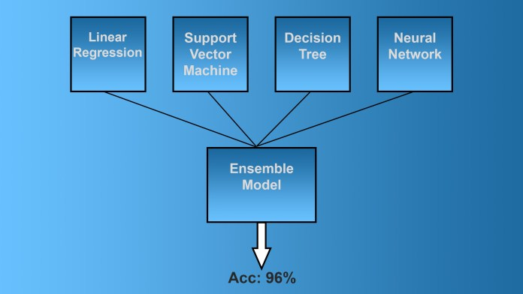
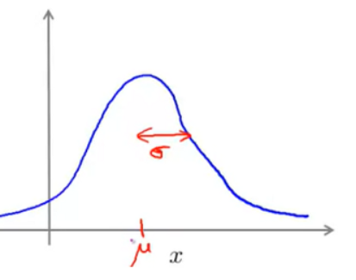
Ensemble Learning
Mean
Variance

Slide 5
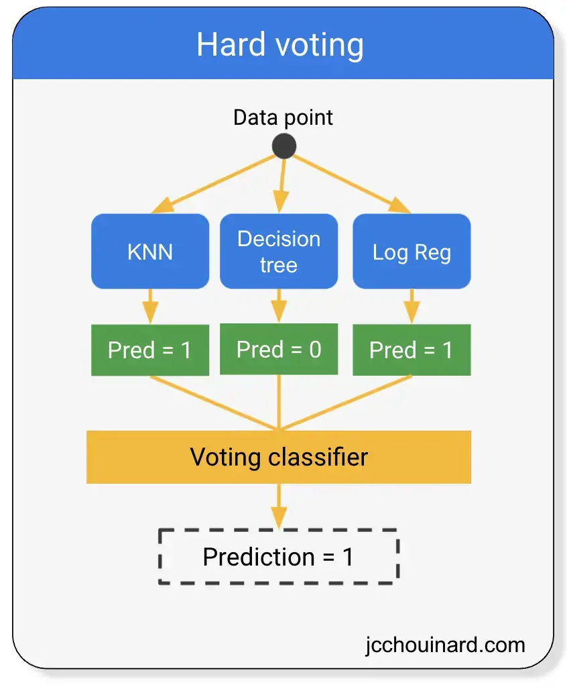
Voting

Slide 6
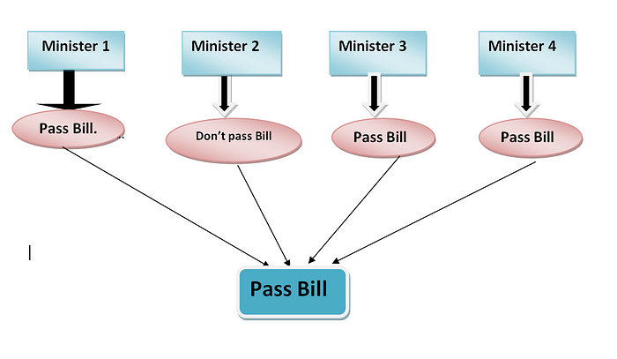
So now, let’s compare it with a real-life example.

Slide 7
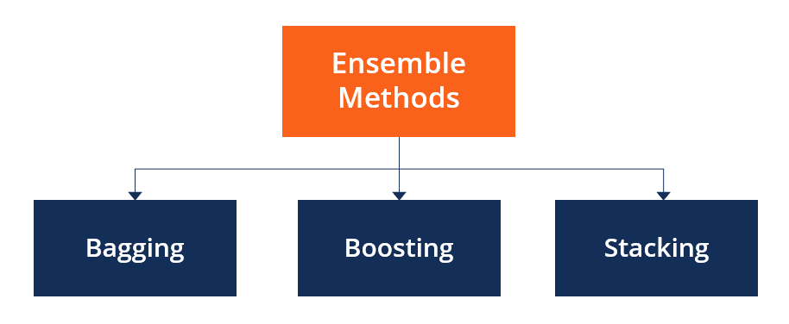
Types of Ensemble Learning

Slide 8
Bagging or Bootstrap
Bagging, also known as bootstrap aggregation, is the ensemble learning method that is commonly used to improve the performance within a noisy dataset.
Bagging of data is used for both regression and classification models.
It is a homogeneous weak learners’ model that learns from each other independently in parallel and combines them for determining the model average.
Bootstrapping is a sampling technique where samples are derived from the whole population (set).
It improves the model’s accuracy.

Slide 9
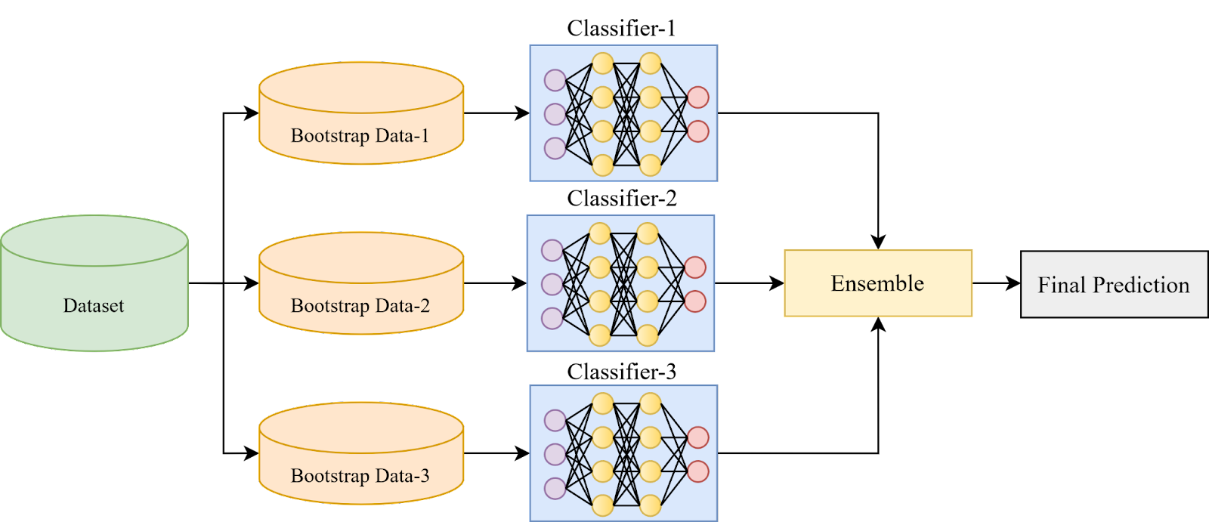
Bagging

Slide 10
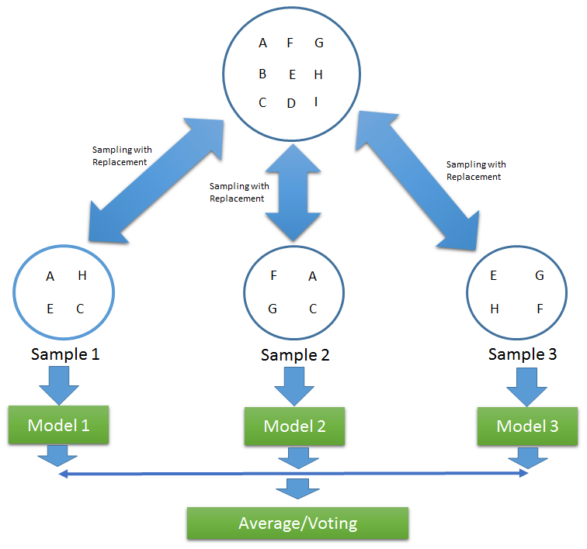
Bagging or Bootstrap

Slide 11
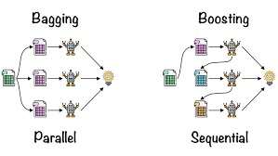
Bagging and Boosting

Slide 12
Boosting
Boosting is an ensemble modeling technique that attempts to build a strong classifier from the number of weak classifiers.
It is done by building a model by using weak models in sequential.
Firstly, a model is built from the training data. Then the second model is built which tries to correct the errors present in the first model. This procedure is continued and models are added until either the complete training data set is predicted correctly or the maximum number of models are added.
Boosting is a method used in machine learning to reduce errors in predictive data analysis.
Boosting is an ensemble learning method that combines a set of weak learners into a strong learner to minimize training errors.

Slide 13
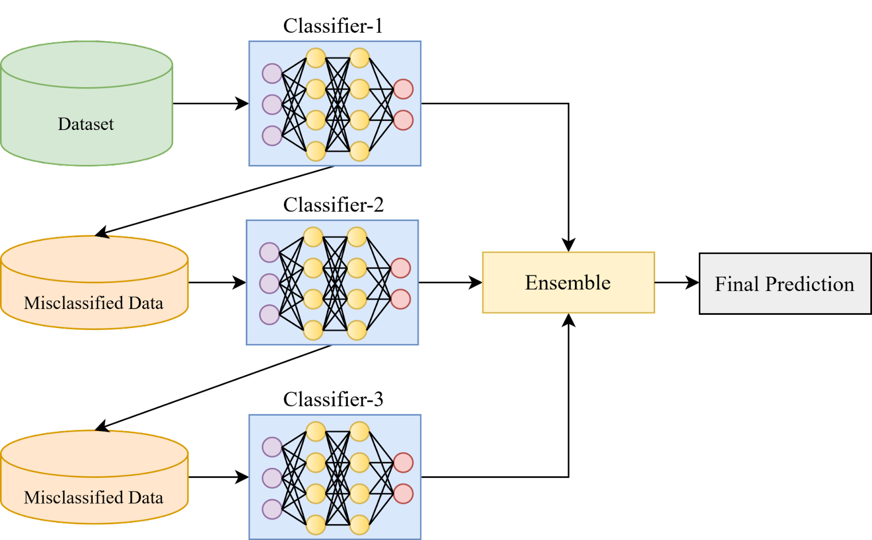
BOOSTING

Slide 14

ADAPTIVE BOOSTING (ADABOOST): This is an ensemble of algorithms, where we build models on the top of several weak learners .

Slide 15
Stacking
Stacking is a process of learning how to create such a stronger model from all weak learners’ predictions.
Stacking is similar to boosting models they produce more robust predictors.
Blending is similar to the stacking approach, except the final model is learning the validation and testing data set along with predictions.

Slide 16
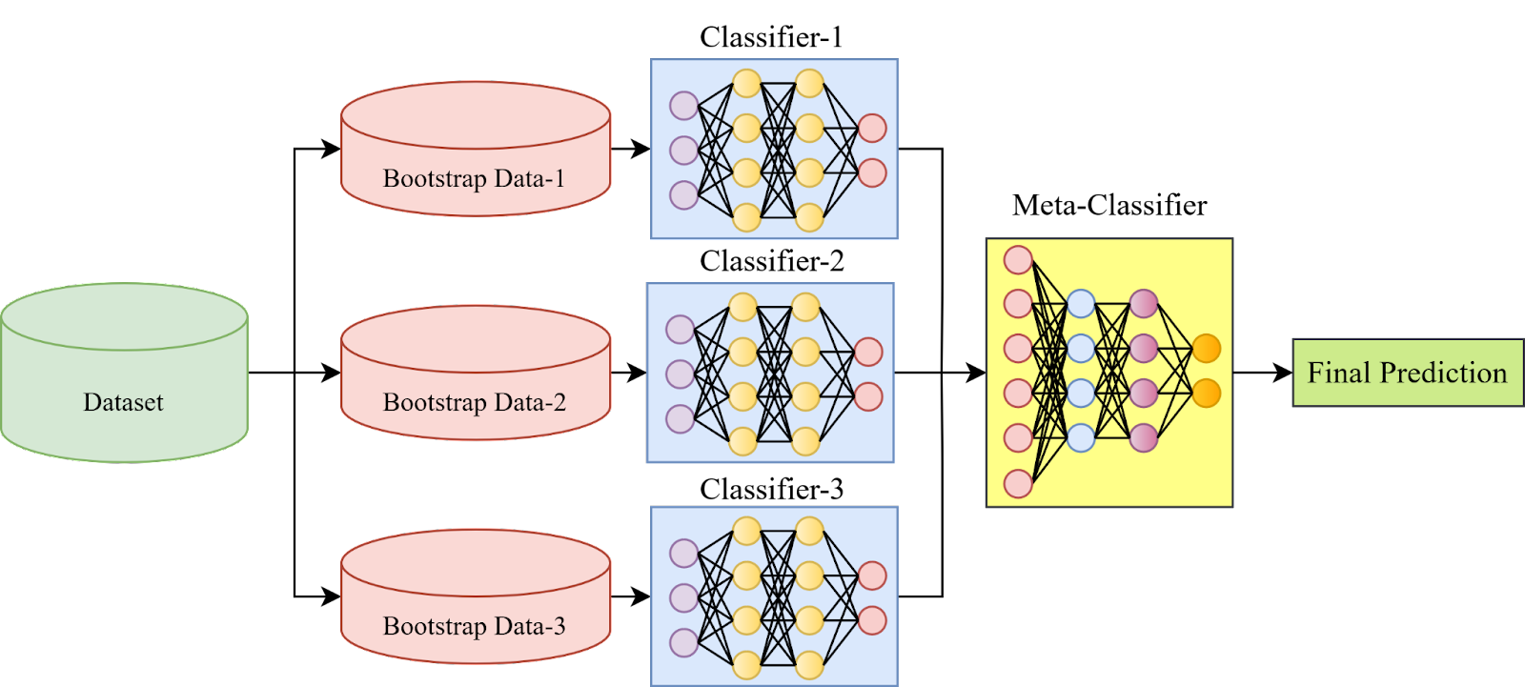
Stacking

Slide 17
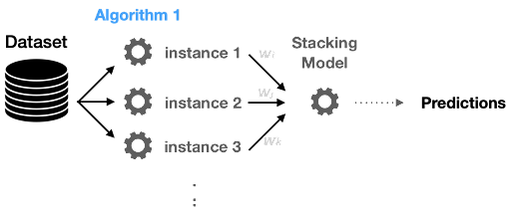
Stacking

Slide 18
Conclusion
An ensemble method is a technique which uses multiple independent similar or different models/weak learners to derive an output or make some predictions
Bagging, also known as bootstrap aggregation, is the ensemble learning method that is commonly used to improve the performance within a noisy dataset.
Boosting is an ensemble modeling technique that attempts to build a strong classifier from the number of weak classifiers.
Stacking is a process of learning how to create such a stronger model from all weak learners’ predictions.

Slide 19
Self-Assessment Questions
Methods of Ensemble learning___________.
Bagging
Boosting
Stacking
All the above
Ensemble means
Extract
remove
grouping
Keeping
19

Slide 20
Self-Assessment Questions
3. Which method is used to reduce errors in data prediction
Bagging
Boosting
Stacking
Blending
4. Example for Bagging is
SVM
Random Forest
Regression
None of the above
20

Slide 21

THANK YOU
OUR TEAM
21

